Slide 1
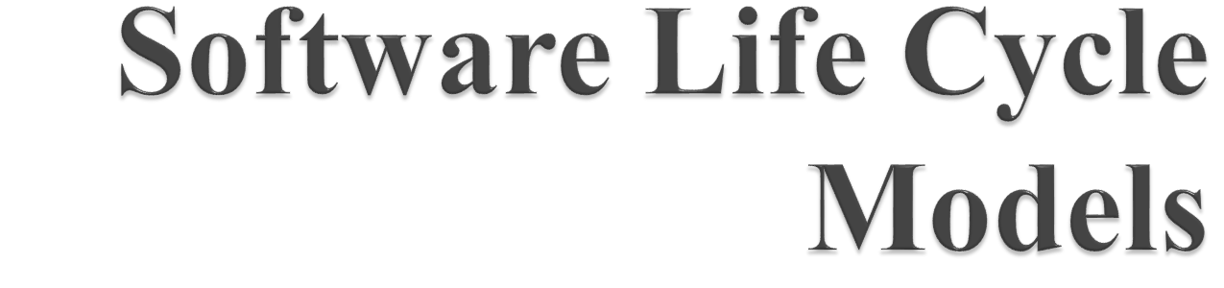

Slide 2

Another popular life cycle model.
This model suggests building a working prototype of the system, before development of the actual software.
A prototype is a toy and crude implementation of a system.

Slide 3
It has limited functional capabilities, low reliability, or inefficient performance as compared to the actual software. A prototype can be built very quickly by using several shortcuts by developing inefficient, inaccurate or dummy functions.

Slide 4

To develop the Graphical User Interface (GUI) part of a software. Through prototype, the user can experiment with a working user interface and they can suggest any change if needed.
When the exact technical solutions are unclear to the development team. A prototype can help them to critically examine the technical issues associated with the product development. The lack of familiarity with a required development technology is a technical risk. This can be resolved by developing a prototype to understand the issues and accommodate the changes in the next iteration.

Slide 5

Prototype model should be used when the desired system needs to have a lot of interaction with the end users. Typically, online systems, web interfaces have a very high amount of interaction with end users, are best suited for Prototype model. It might take a while for a system to be built that allows ease of use and needs minimal training for the end user. Prototyping ensures that the end users constantly work with the system and provide a feedback which is incorporated in the prototype to result in a useable system. They are excellent for designing good human computer interface systems.

Slide 6

The Prototyping Model of software development is graphically shown in the next slide. The software is developed through two major activities – one is prototype construction and another is iterative waterfall based software development.

Slide 7
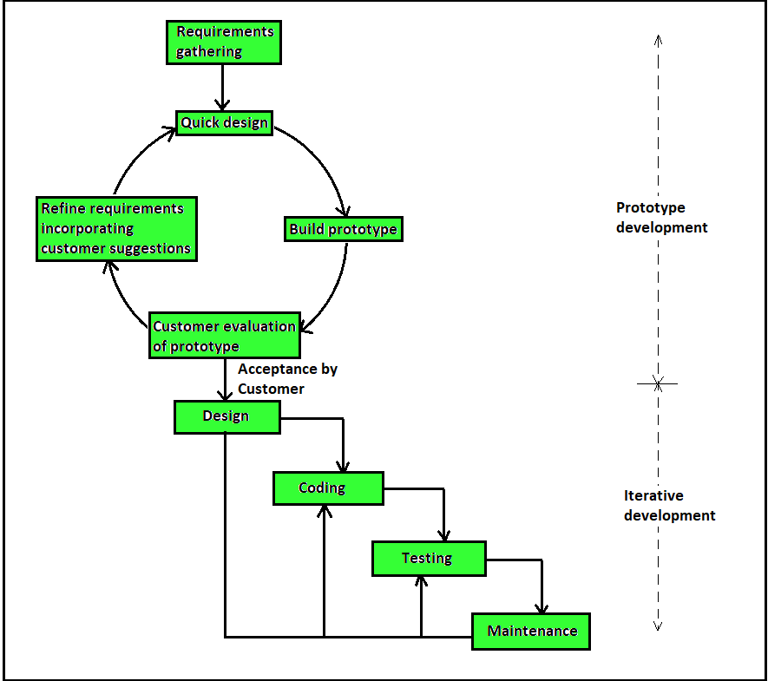

Slide 8
Prototype Development – Prototype development starts with an initial requirements gathering phase. A quick design is carried out and a prototype is built. The developed prototype is submitted to the customer for evaluation. Based on the customer feedback, the requirements are refined and the prototype is suitably modified. This cycle of obtaining customer feedback and modifying the prototype continues till the customer approves the prototype.

Slide 9
Iterative Development – Once the customer approves the prototype, the actual software is developed using the iterative waterfall approach. In spite of the availability of a working prototype, the SRS document is usually needed to be developed since the SRS Document is invaluable for carrying out traceability analysis, verification and test case design during later phases.

Slide 10
The code for the prototype is usually thrown away. However, the experience gathered from developing the prototype helps a great deal in developing the actual software. By constructing the prototype and submitting it for user evaluation, many customer requirements get properly defined and technical issues get resolved by experimenting with the prototype. This minimises later change requests from the customer and the associated redesign costs.

Slide 11

Strengths of prototype model are:
a) Gains customer’s confidence as developers and customers are in sync with each other’s expectations continuously.
b) Ideal for online systems where high level of human computer interaction is involved.
c) Very flexible, as changes in requirements can be accommodated much more easily with every new review and refining.
d) Helps the developers and users both understand the system better.

Slide 12
e) Software built through prototyping needs minimal user training as users get trained using the prototypes on their own from the very beginning of the project.
f) Integration requirements are very well understood and deployment channels are decided at a very early stage.

Slide 13

Cost of the development of the software by using prototyping model can increase in various cases where the risks are very less.
It may take more time to develop a software by using Prototyping model.
The Prototyping model is effective only for those projects for which the risks can be identified before the development starts. Since the prototype is developed at the start of the project, so the Prototyping model is ineffective for risks that identified after the development phase starts.

Slide 14

Spiral model is one of the most important Software Development Life Cycle models, which provides support for Risk Handling.
In its diagrammatic representation, it looks like a spiral with many loops.
The exact number of loops of the spiral is unknown and can vary from project to project.
Each loop of the spiral is called a Phase of the software development process.

Slide 15
The exact number of phases needed to develop the product can be varied by the project manager depending upon the project risks.
As the project manager dynamically determines the number of phases, so the project manager has an important role to develop a product using spiral model.

Slide 16
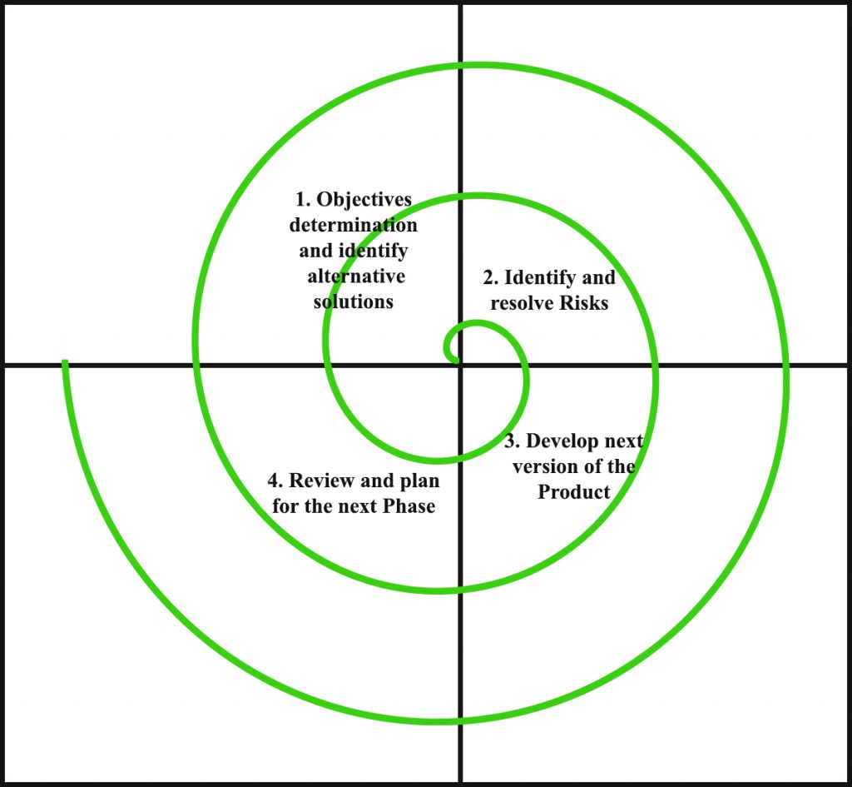

Slide 17

“Risk is future uncertain events with a probability of occurrence and a potential for loss”
“A Risk is essentially any adverse circumstance that might hamper the successful completion of a software project.”
Schedule / Time-Related / Delivery Related Planning Risks.
Budget / Financial Risks.
Operational / Procedural Risks.
Technical / Functional / Performance Risks.
Other Unavoidable Risks.

Slide 18
Each phase of Spiral Model is divided into four quadrants as shown in the above figure. The functions of these four quadrants are discussed below-
Objectives determination and identify alternative solutions: Requirements are gathered from the customers and the objectives are identified, elaborated and analyzed at the start of every phase. Then alternative solutions possible for the phase are proposed in this quadrant.

Slide 19
Identify and resolve Risks: During the second quadrant all the possible solutions are evaluated to select the best possible solution. Then the risks associated with that solution is identified and the risks are resolved using the best possible strategy. At the end of this quadrant, Prototype is built for the best possible solution.

Slide 20
Develop next version of the Product: During the third quadrant, the identified features are developed and verified through testing. At the end of the third quadrant, the next version of the software is available.
Review and plan for the next Phase: In the fourth quadrant, the Customers evaluate the so far developed version of the software. In the end, planning for the next phase is started.

Slide 21

A risk is any adverse situation that might affect the successful completion of a software project. The most important feature of the spiral model is handling these unknown risks after the project has started. Such risk resolutions are easier done by developing a prototype. The spiral model supports coping up with risks by providing the scope to build a prototype at every phase of the software development.

Slide 22
Prototyping Model also support risk handling, but the risks must be identified completely before the start of the development work of the project. But in real life project risk may occur after the development work starts, in that case, we cannot use Prototyping Model. In each phase of the Spiral Model, the features of the product dated and analyzed and the risks at that point of time are identified and are resolved through prototyping. Thus, this model is much more flexible compared to other SDLC models.

Slide 23

The Spiral model is called as a Meta Model because it subsumes all the other SDLC models. For example, a single loop spiral actually represents the Iterative Waterfall Model. The spiral model incorporates the stepwise approach of the Classical Waterfall Model. The spiral model uses the approach of Prototyping Model by building a prototype at the start of each phase as a risk handling technique. Also, the spiral model can be considered as supporting the evolutionary model – the iterations along the spiral can be considered as evolutionary levels through which the complete system is built.

Slide 24

Risk Handling: The projects with many unknown risks that occur as the development proceeds, in that case, Spiral Model is the best development model to follow due to the risk analysis and risk handling at every phase.
Good for large projects: It is recommended to use the Spiral Model in large and complex projects.

Slide 25
Flexibility in Requirements: Change requests in the Requirements at later phase can be incorporated accurately by using this model.
Customer Satisfaction: Customer can see the development of the product at the early phase of the software development and thus, they habituated with the system by using it before completion of the total product.

Slide 26

Complex: The Spiral Model is much more complex than other SDLC models.
Expensive: Spiral Model is not suitable for small projects as it is expensive.
Too much dependable on Risk Analysis: The successful completion of the project is very much dependent on Risk Analysis. Without very highly experienced expertise, it is going to be a failure to develop a project using this model.
Difficulty in time management: As the number of phases is unknown at the start of the project, so time estimation is very difficult.

